Slide 1
DATA: Screening
DENV-2

Slide 2
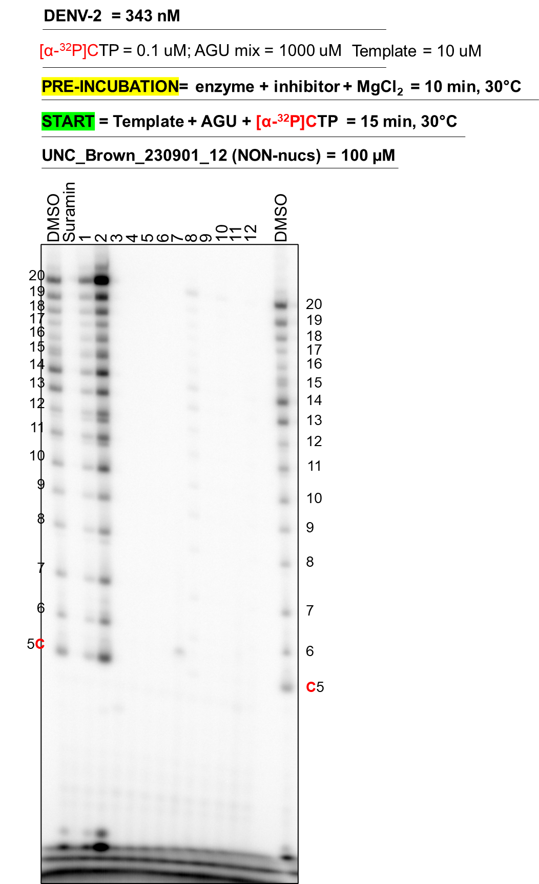
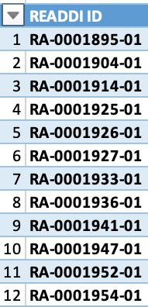
Assay principle
3’UCUUGGACAACUAAGUUGUC²⁰p
de novo
RNA synthesis
DENV-2 ns5
(A_GU)TP mix = 1000 uM
[α-³²P]CTP = 0.1 uM
MgCl₂
3’UCUUGGACAACUAAGUUGUCp
5’pppAGAAC₅------------->₂₀
Data was generated by Simon Walker

Slide 3
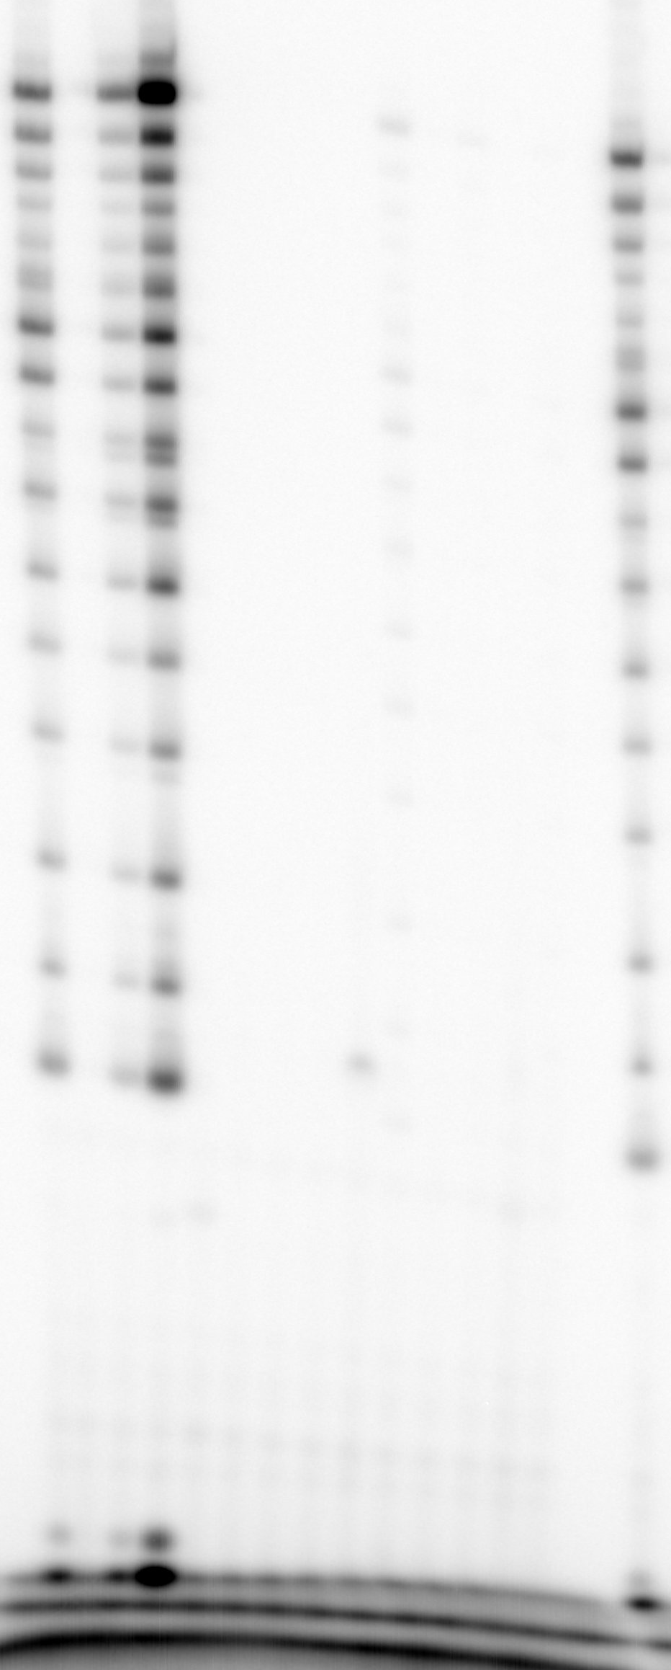
DENV-2
= 343 nM
[α-³²P]CTP = 0.1 uM; AGU mix = 1000 uM
Template = 10 uM
PRE-INCUBATION= enzyme + inhibitor + MgCl₂ = 10 min, 30°C
START = Template + AGU + [α-³²P]CTP = 15 min, 30°C
UNC_Brown_230901_12 (NON-nucs) = 100 µM
Suramin
DMSO
DMSO
1
2
3
4
5
6
7
8
9
10
11
12
20
19
20
18
17
19
16
18
15
17
14
16
13
15
12
14
11
13
10
12
11
9
10
8
9
7
8
6
7
5C
6
C5

